Slide 1
How to deploy and control the workloads for your applications on Red Hat OpenShift Masa Abushamleh Developer Advocate, UAE Asna Javed Lead Developer Advocate, PAK

Slide 2

Agenda
Red Hat OpenShift for Developers 5
Builds 7 Build & BuildConfig
Build Strategies 8 Docker build 9 S2I build 10 Custom build 12
Scaling Applications 13
Update & Rollback 14
Hands-on 15

Slide 3

Let’s Get Started
Signup/Sign-in on IBM: https://ibm.biz/oc-deploy
Tutorial: https://ibm.biz/oc-deploy-tutorial
OpenShift Cluster
URL: https://ibm.biz/oc-deploy-cluster
Key: oslab

Slide 4
We are also live on
Crowdcast crowdcast.io/e/manage-app-kube
YouTube youtu.be/j2ZrZxSutmI
Twitch twitch.tv/ibmdeveloper
FB facebook.com/IBMDeveloper
Twitter twitter.com/ibmdeveloper
Notes:
Crowdcast https://www.crowdcast.io/e/manage-app-kube
YouTube https://youtu.be/j2ZrZxSutmI
Twitch twitch.tv/ibmdeveloper

Slide 5
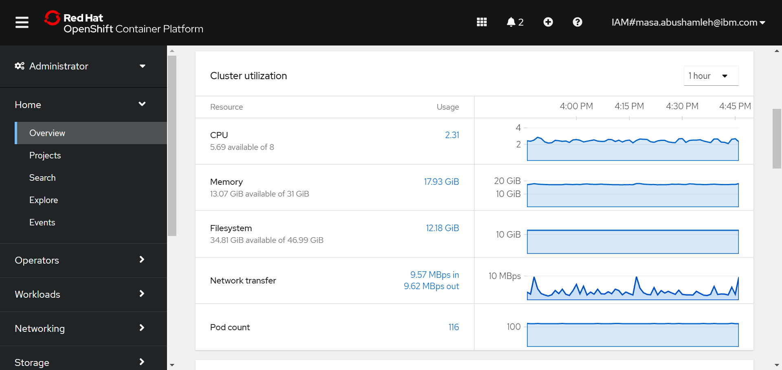
Red Hat OpenShift
Get Started here: https://ibm.biz/oc-deploy
Notes:
Creating and deploying applications by importing existing codebases, images, and dockerfiles
Visually interacting with applications and components within a project and monitoring their deployment and build status
Grouping components within an application and across applications
Integrating serverless capabilities

Slide 6
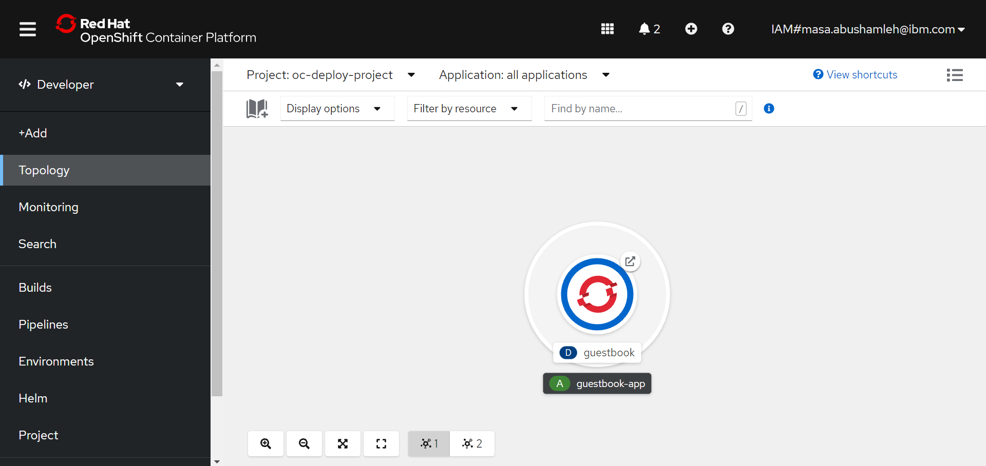
Red Hat OpenShift
Get Started here: https://ibm.biz/oc-deploy
Notes:
Creating and deploying applications by importing existing codebases, images, and dockerfiles
Visually interacting with applications and components within a project and monitoring their deployment and build status
Grouping components within an application and across applications
Integrating serverless capabilities

Slide 7
Red Hat OpenShift for Developers
Creating and deploying applications by importing existing codebases, images, and Dockerfiles
Grouping components within an application and across applications
Visually interacting with applications and components within a project and monitoring their deployment and build status
Integrating serverless capabilities
Notes:
Creating and deploying applications by importing existing codebases, images, and dockerfiles
Visually interacting with applications and components within a project and monitoring their deployment and build status
Grouping components within an application and across applications
Integrating serverless capabilities

Slide 8
Build & BuildConfig
Get Started here: https://ibm.biz/oc-deploy
A BuildConfig object is the definition of the entire build process. It describes a single build definition and a set of triggers for when a new build should be created.
A build is the process of transforming input parameters into a resulting object. (input parameters or source code into a runnable image).
Trigger 1
Build 1
BuildConfig
Trigger 2
Build 2
Trigger 3
Build 3
Notes:
https://docs.openshift.com/container-platform/3.9/dev_guide/builds/index.html
A build configuration describes a single build definition and a set of triggers for when a new build should be created. Build configurations are defined by a BuildConfig, which is a REST object that can be used in a POST to the API server to create a new instance.
BuildConfig results in a new build every time a container image tag or the source code changes

Slide 9

Build Strategies
Get Started here: https://ibm.biz/oc-deploy
Docker build
Source-to-Image (S2I) build
Custom build
By default, Docker builds and S2I builds are supported.
Image source: undraw
Notes:
The resulting object of a build depends on the builder used to create it. For Docker and S2I builds, the resulting objects are runnable images. For Custom builds, the resulting objects are whatever the builder image author has specified.

Slide 10
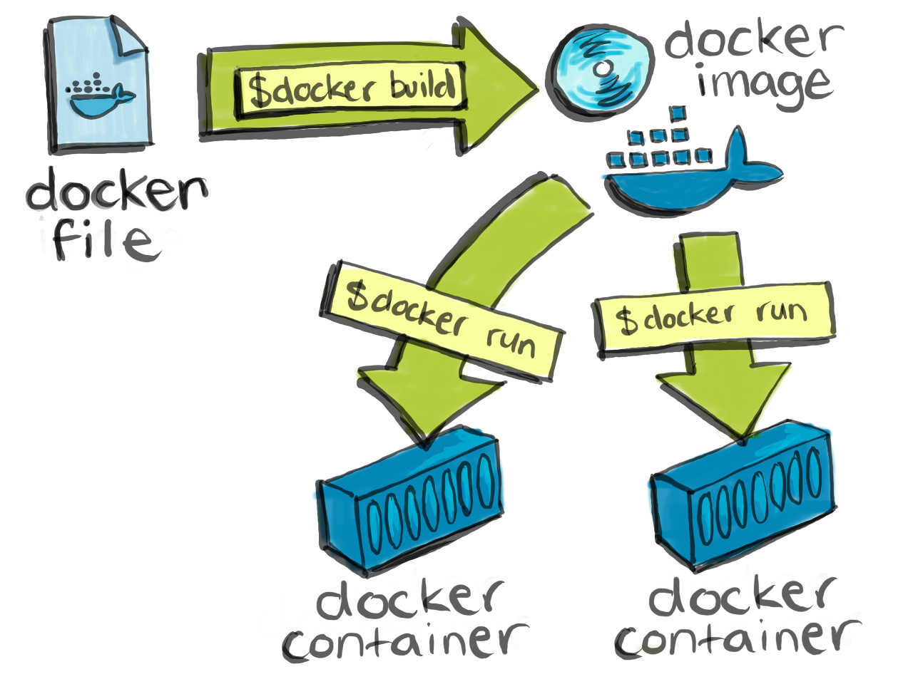
Build Strategies: Docker Build
Get Started here: https://ibm.biz/oc-deploy
Invokes the plain docker build command, so it expects a repository with a Dockerfile and all required artifacts in it to produce a runnable image.
OpenShift uses Buildah to build a container image from a Dockerfile
Source: https://cultivatehq.com/posts/docker/
Notes:
https://cultivatehq.com/posts/docker/
https://docs.openshift.com/container-platform/3.9/architecture/core_concepts/builds_and_image_streams.html#docker-build

Slide 11
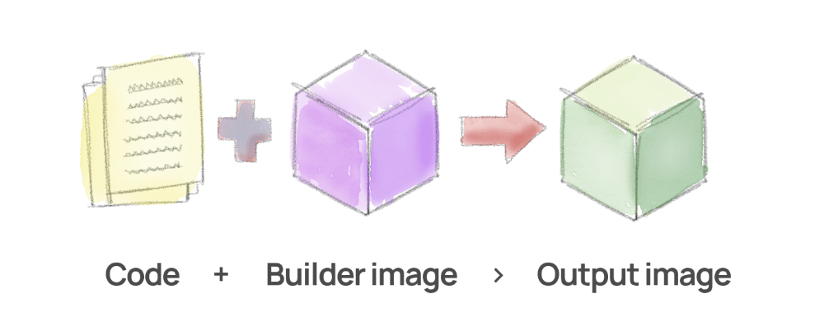
Build Strategies: Source-to-Image (S2I) Build
Get Started here: https://ibm.biz/oc-deploy
Produces ready-to-run images by injecting application source into a Docker image and assembling a new Docker image.
oc new-app <git-url>
Files | Language builder | Programming language
Dockerfile | N/A | Dockerfile build
pom.xml | jee | Java (with Jboss EAP)
app.json, package.json | nodejs | Node.js (JavaScript)
pomposer.json, index.php | php | PHP
Image source: https://tomd.xyz/openshift-s2i-example/
Notes:
Builds reproducible Docker images.
OpenShift can create applications directly from source code stored in a Git repository. The simpler
syntax for the oc new-app command requires only the Git repository URL as an argument, and
then OpenShift tries to auto-detect the programming language used by the application and select
a compatible builder image
The new image incorporates the base image (the builder) and built source and is ready to use with the docker run command. S2I supports incremental builds, which re-use previously downloaded dependencies, previously built artifacts, etc.
Advantages:
Image flexibility
Speed
Patchability
Operational efficiency
Operational security
User efficiency
Ecosystem

Slide 12
S2I build process
Get Started here: https://ibm.biz/oc-deploy
oc new-app <URL>
URL is a container registry URL?
Yes
Deploy the container image
No
URL points to a Git repository?
No
Error
Yes
Repository contains Dockerfile
Yes
Build container with strategy=docker
No
Build container with strategy=source
Image Stream support=builder-language
No
Build container
Yes
Search Image Stream with same name

Slide 13
Custom Build
Get Started here: https://ibm.biz/oc-deploy
Define a specific builder image responsible for the entire build process.
Using your own builder image allows you to customize your build process.
A custom builder image is a plain container image embedded with build process logic
Custom builds run with a high level of privilege. Only for users with cluster administration permission.
Notes:
The custom build strategy allows developers to define a specific builder image responsible for the entire build process. Using your own builder image allows you to customize your build process.
A custom builder image is a plain container image embedded with build process logic, for example for building RPMs or base images.
Custom builds run with a high level of privilege and are not available to users by default. Only users who can be trusted with cluster administration permissions should be granted access to run custom builds.

Slide 14

Scaling Applications
Get Started here: https://ibm.biz/oc-deploy
Having multiple replicas of a pod can help you ensure that your deployment has the available resources to handle increasing load on your application.
oc scale --replicas=5 deployment/myguestbook
oc autoscale dc/frontend --min 1 --max 10 --cpu-percent=80
Image source: canva

Slide 15

Update & Rollback
Get Started here: https://ibm.biz/oc-deploy
oc rollout undo deployment/myguestbook
oc set image deployment/myguestbook guestbook=ibmcom/guestbook:v2
Images source: canva

Slide 16
Let’s Get Started
Signup/Sign-in on IBM: https://ibm.biz/oc-deploy
Tutorial: https://ibm.biz/oc-deploy-tutorial
OpenShift Cluster
URL: https://ibm.biz/oc-deploy-cluster
Key: oslab

Slide 17


Let us know how we are doing!
Survey link http://ibm.biz/oc-deploy-survey

Slide 18

Join our Facebook Community: IBM Developer MEA
Get Started here: https://ibm.biz/oc-deploy
fb.com/groups/ibmdevelopermea/

Slide 19

Thank you!
Let us know how we did!
Asna Javed Lead Developer Advocate, PAK asna.javed1@ibm.com
linkedin.com/in/asnajaved/
-
Masa Abushamleh Developer Advocate, UAE
masa.abushamleh@ibm.com linkedin.com/in/masa-abushamleh/
Survey link: https://ibm.biz/Bdf8Aj

